Slide 1

Photo journalism
JST 05104
MODULE

Slide 2
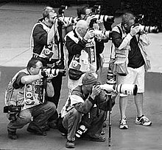
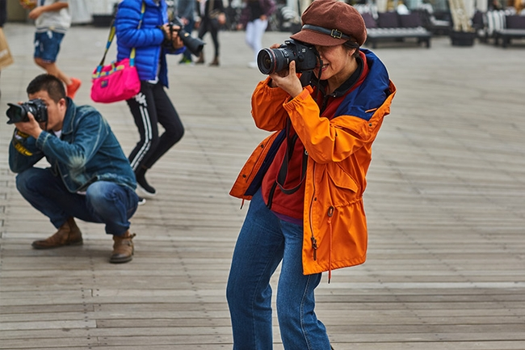
What exactly is photojournalism

Slide 3
Photojournalism is an effective way of telling stories and disseminating information to a diverse group of people through an image.
It gives visual support to the news
story.

Slide 4
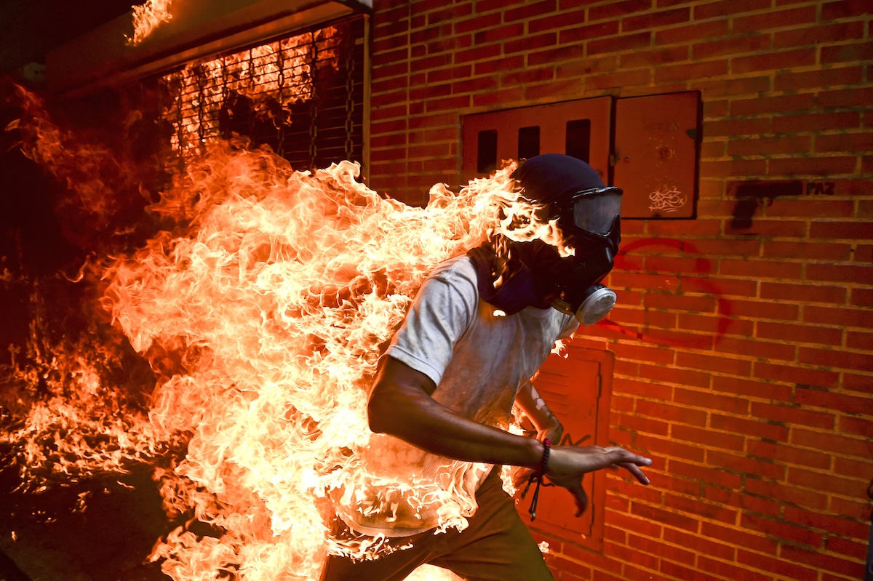
How does a photograph qualify to be a photojournalism?

Slide 5
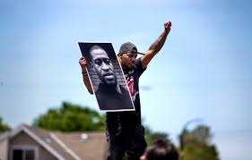
Does it tell or relates with the story written ?

Slide 6
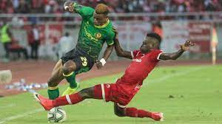
Does it focus on the latest news or event

Slide 7
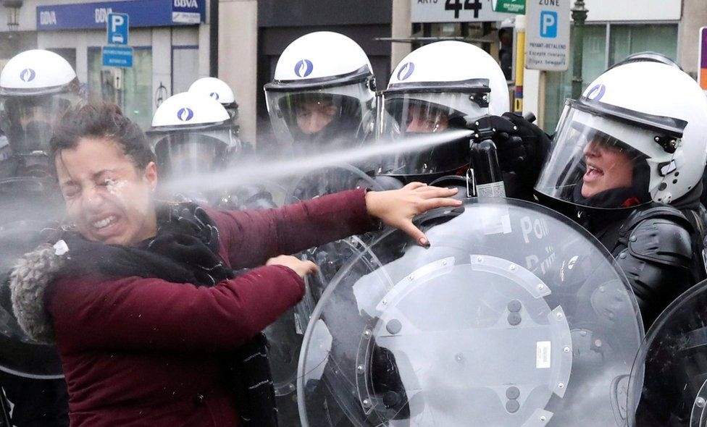
Does the image shows objective and honest ?

Slide 8
Does it answer the maximum number of
Ws and H questions

Slide 9
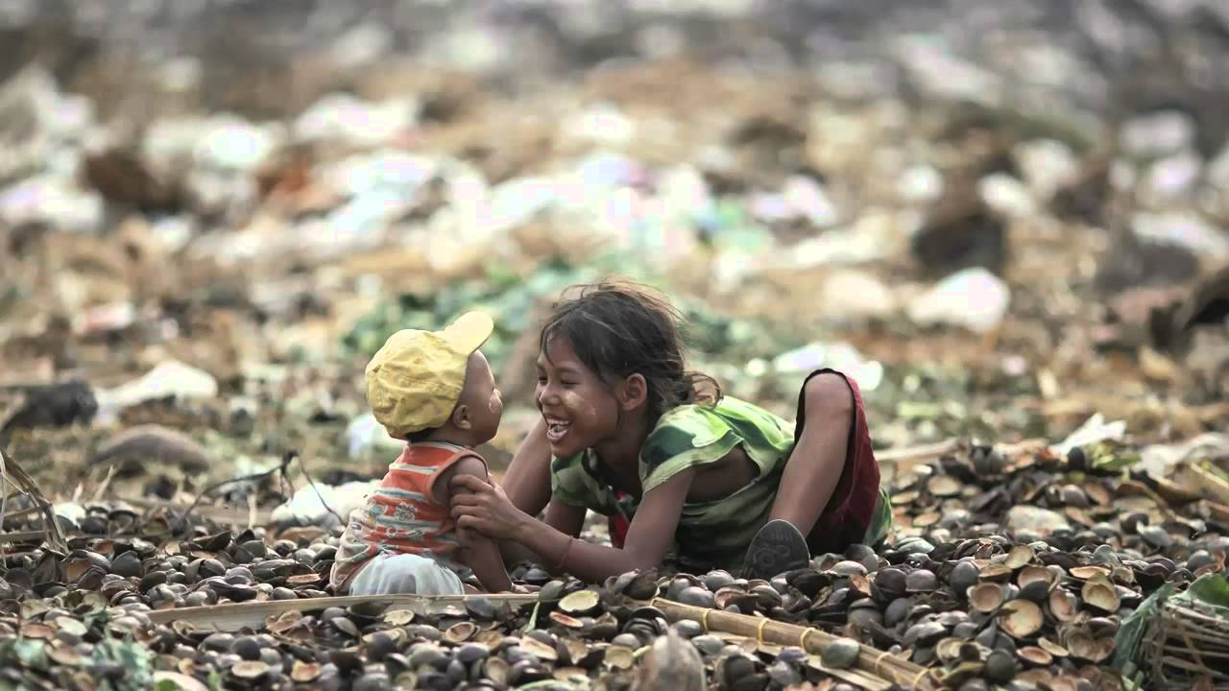
Or was it taken with the right exposure, angle, color and focus

Slide 10
If all answers are yes, then that qualifies to be a photojournalism

Slide 11
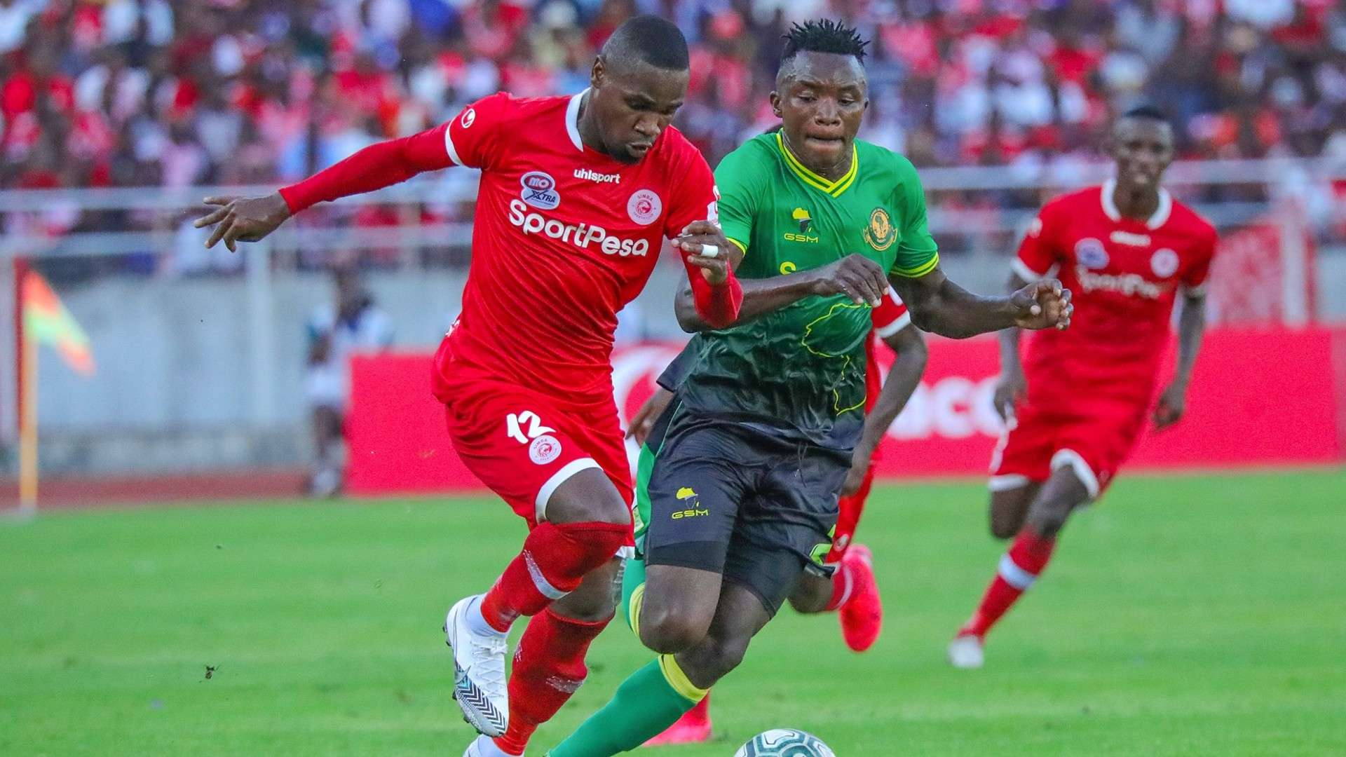
Types of Photojournalism
Sports photojournalism

Slide 12
Types of Photojournalism
Sports photojournalism
As sports events are a big part of news, there are photojournalists who specialize in photographing sports.
This is also because sports photography requires a specialized skill as well as equipment.
Nowadays there are photojournalists who specialize in photographing individual sports.

Slide 13
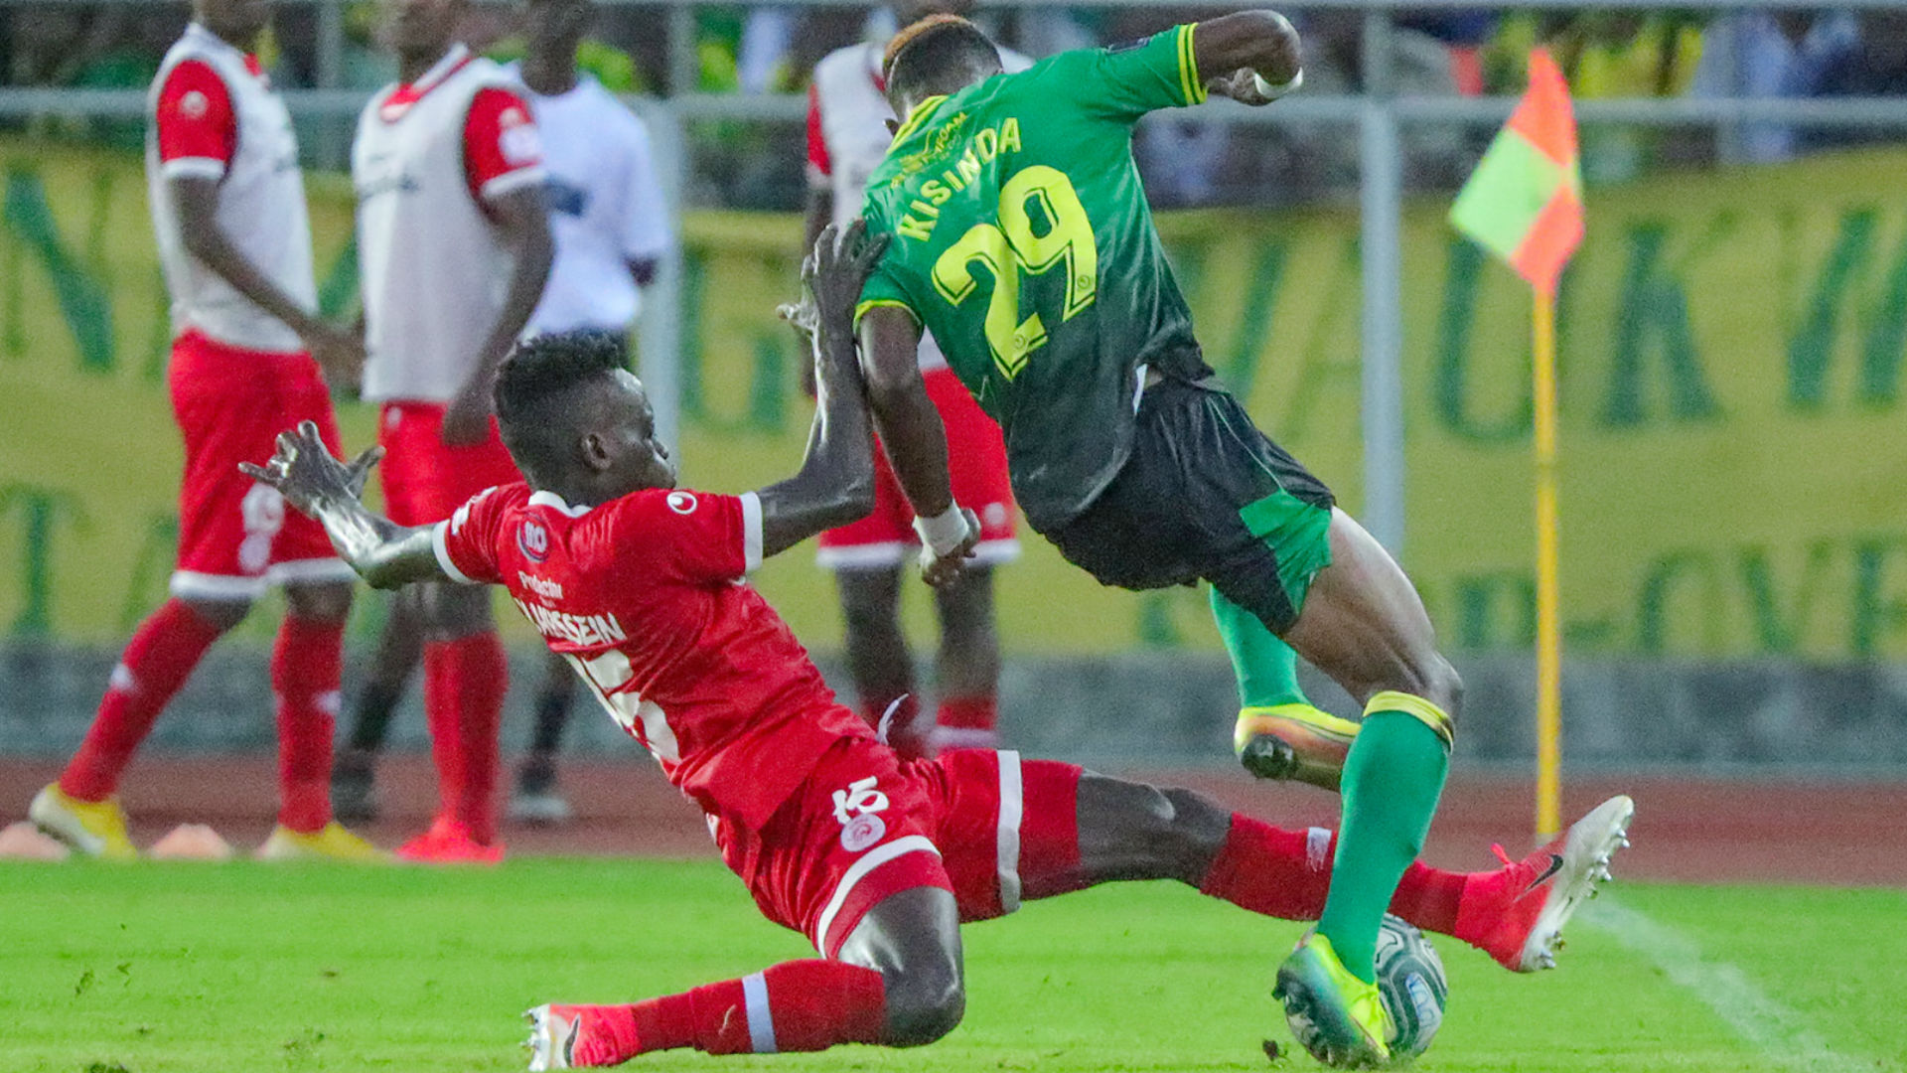
Types of Photojournalism
Sports photojournalism
For example in Tanzania, there are people who dedicated in football as it is well loved sport in the country.

Slide 14
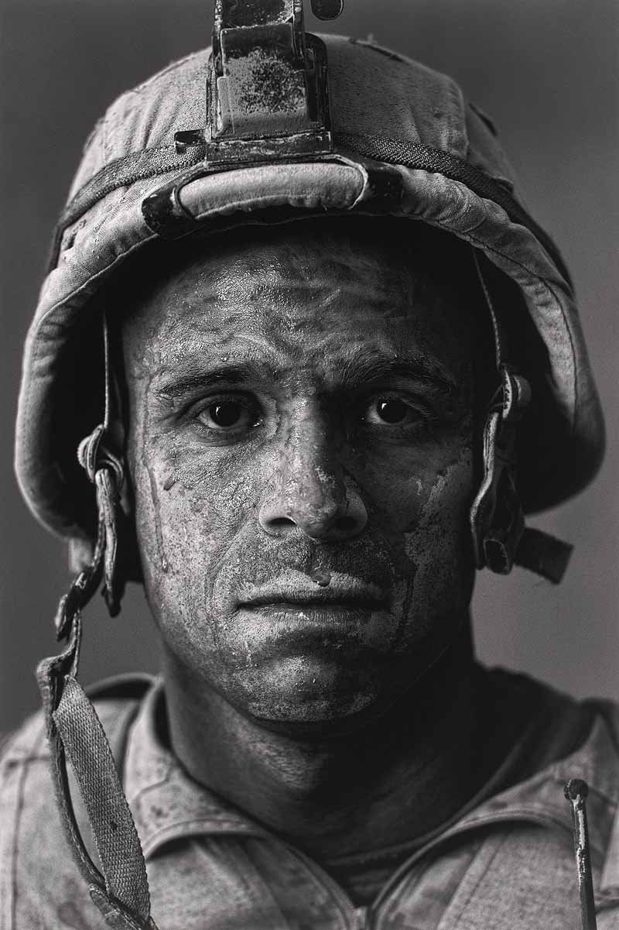
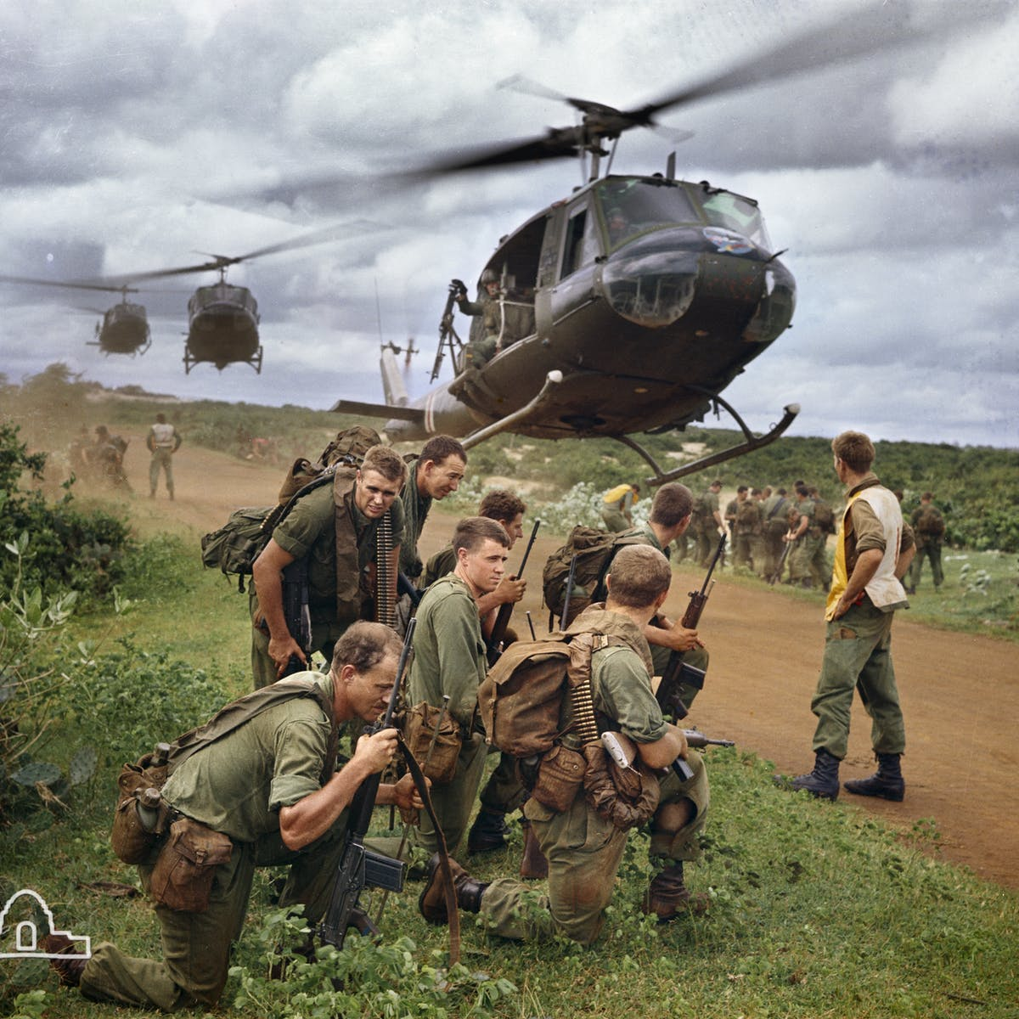
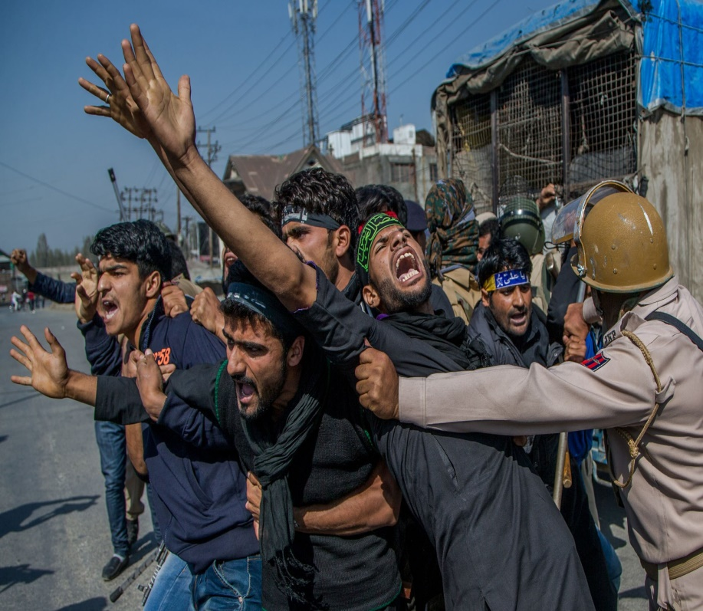
Types of Photojournalism
War photojournalism

Slide 15
Types of Photojournalism
War photojournalism
This is the earliest form of photojournalism, where photojournalists have covered wars and sent photos from the center of action.

Slide 16
Types of Photojournalism
War photojournalism
This is the earliest form of photojournalism, where photojournalists have covered wars and sent photos from the center of action.
The photographer is in a
dangerous situation and yet he manages to send us pictures, risking his life.

Slide 17

Types of Photojournalism
Glamour photojournalism

Slide 18
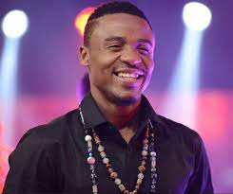
Types of Photojournalism
Glamour photojournalism
Film stars and other famous personalities have
become a major part of news coverage as most people want to peep into
the lives of the rich and famous. There are photojournalists who specialize in
this kind of photography only are also called paparazzi, which is an Italian
word..

Slide 19
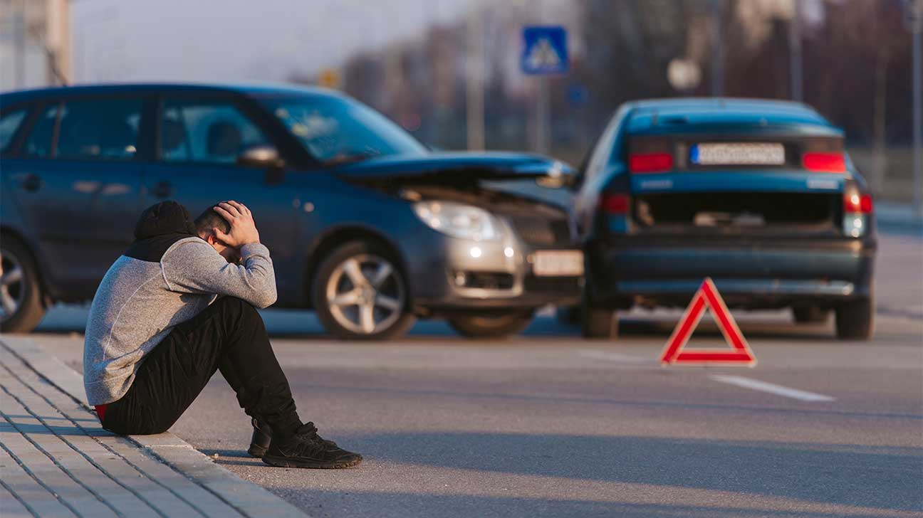
Types of Photojournalism
Spot news photojournalism
This means covering events that make day to day news, like political events, crime, accidents etc. This is in fact the most
common type of photojournalism and is most demanding for a photojournalist

Slide 20

Types of Photojournalism
Travel photojournalism
This type of photojournalism involves the
documentation of an area’s landscape, people, cultures, customs and
history.

Slide 21
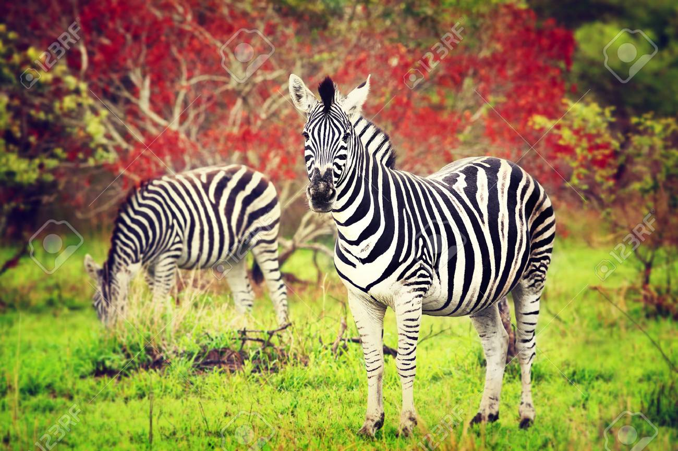
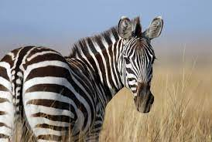
Types of Photojournalism
Wilde life photojournalism
This is regarded as one of the more challenging forms of photojournalism.
Advanced photographic equipment as well as a good knowledge of the animal’s behavior as well as the terrain is needed to take wildlife photographs.

Slide 22
Conclusion
Photojournalists can be of two kinds, those who are employed by the newspaper and the others who work as freelancers i.e. those who work independently and sell the pictures that they take to newspapers and other news agencies.
Photojournalism is now no longer limited to newspapers. With the emergence of the internet as a major source of news, the scope of photojournalism has extended itself into what is known as web based photo journalism.

Slide 23
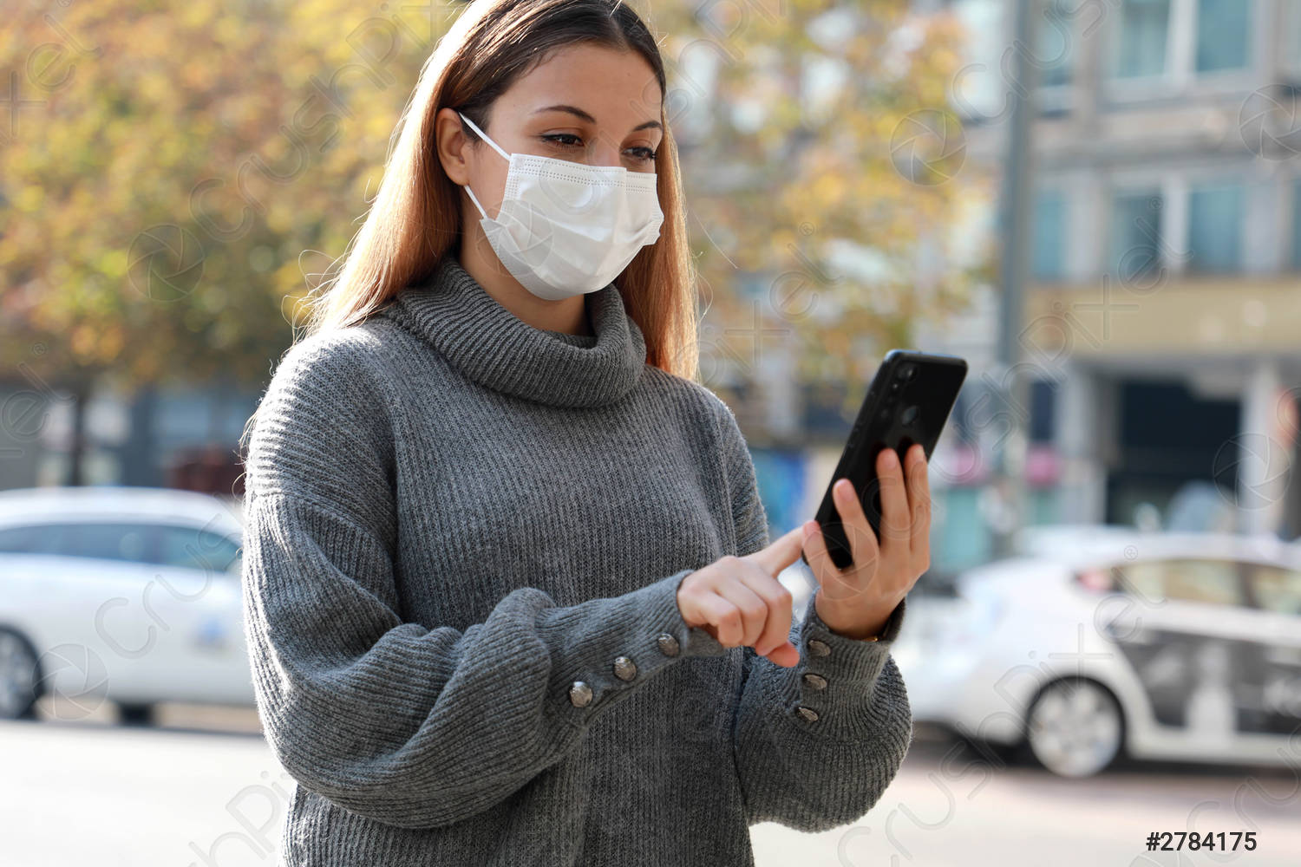
Conclusion
Now with so many people carrying the camera in their phones, it may be of interest for you to know that newspapers and websites use photos sent by people like us to them, because we as ordinary people may be present with our mobile phone cameras at places when an incident of interest to the newspaper may take place!.

Slide 24
Question ?
Can this person considered to be a photojournalist ?
Why?

Slide 25
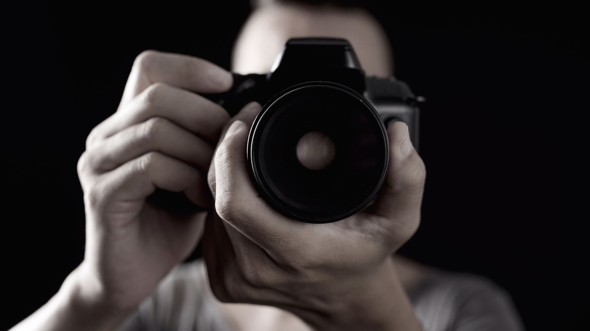
Question ?
What are the roles and responsibility of a photojournalist in the media and society?

Slide 26
Question ?
What is the common type of photojournalism ?

Slide 27
The end, next is Composition get prepared…

