Slide 1
Composition
The art of Framing your photography
By Mr.Sameer Mbaraka

Slide 2
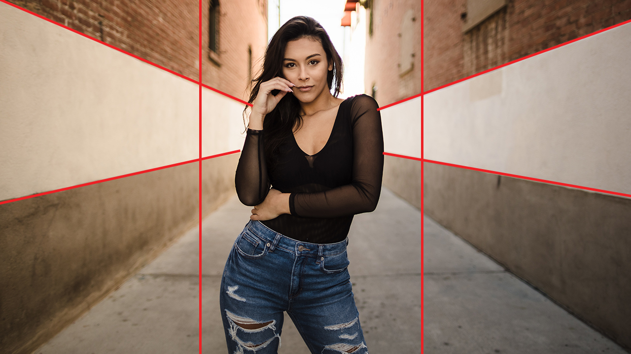
What exactly is composition

Slide 3

Composition
The term “composition” applies not only to visual arts, but to music, dance, literature and virtually any other kind of art.
“composition” describes placement of relative objects and elements in a work of art

Slide 4
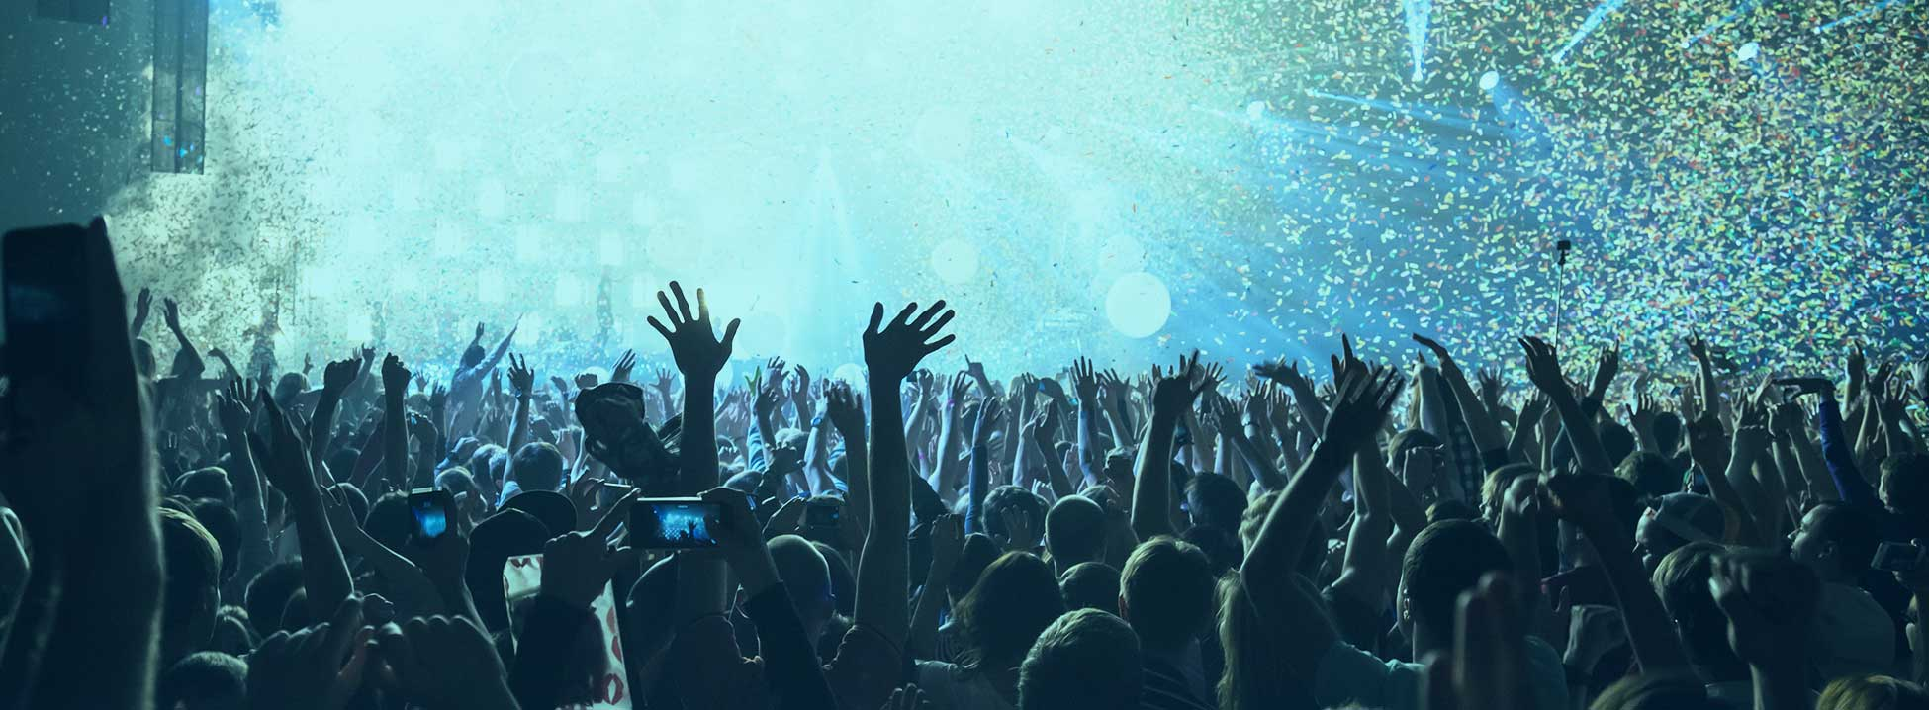
composition
A good composition is one that has just enough detail. Too few elements is bad because it robs the work of art of necessary detail that makes correct interpretation possible. It also ruins the balance of an image. And too many elements can be very distracting as well. Good composition requires good balance. It is best to make sure all the elements present are necessary for the idea or story you are trying to pass on.

Slide 5
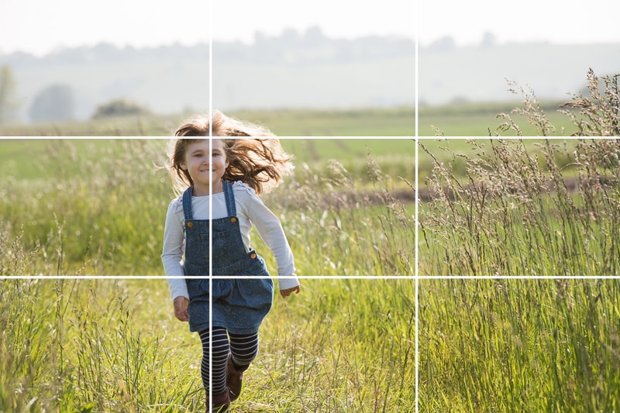
Composition in Photography
Simply put, composing an image.
Means arranging elements within it in a way that suits the core idea or goal of your work best. Arranging elements can be done by actually moving the objects or subjects. A good example for this case is portrait or still life photography.

Slide 6
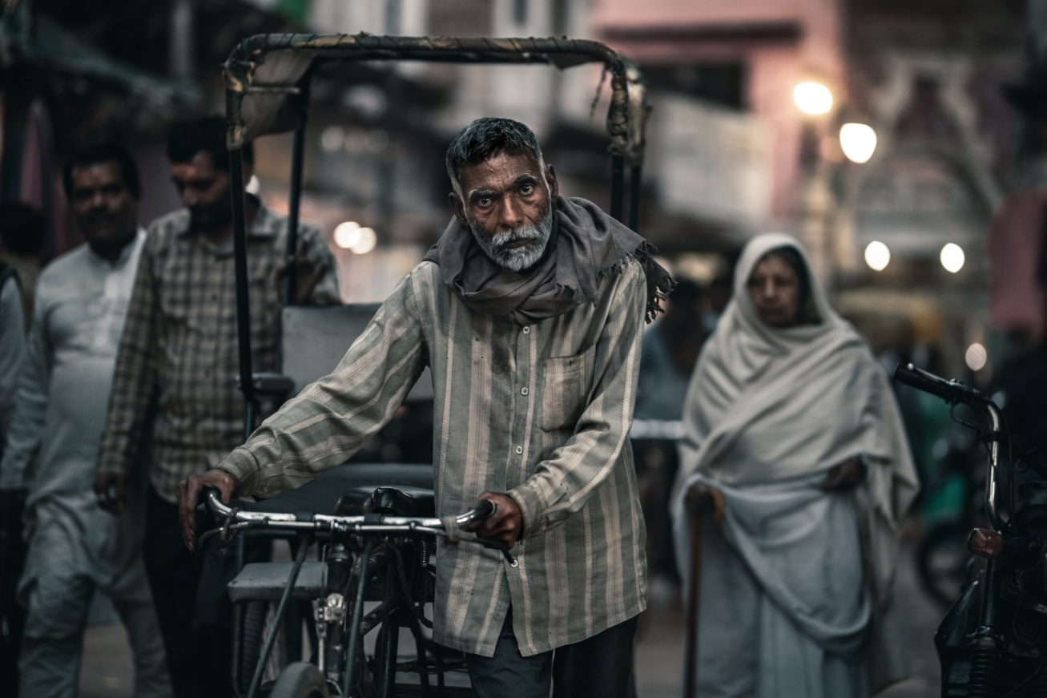
Composition in Photography
Another way of arranging elements is by changing your own position. Such a way is appropriate in circumstances that do not allow the photographer to physically move anything,

Slide 7
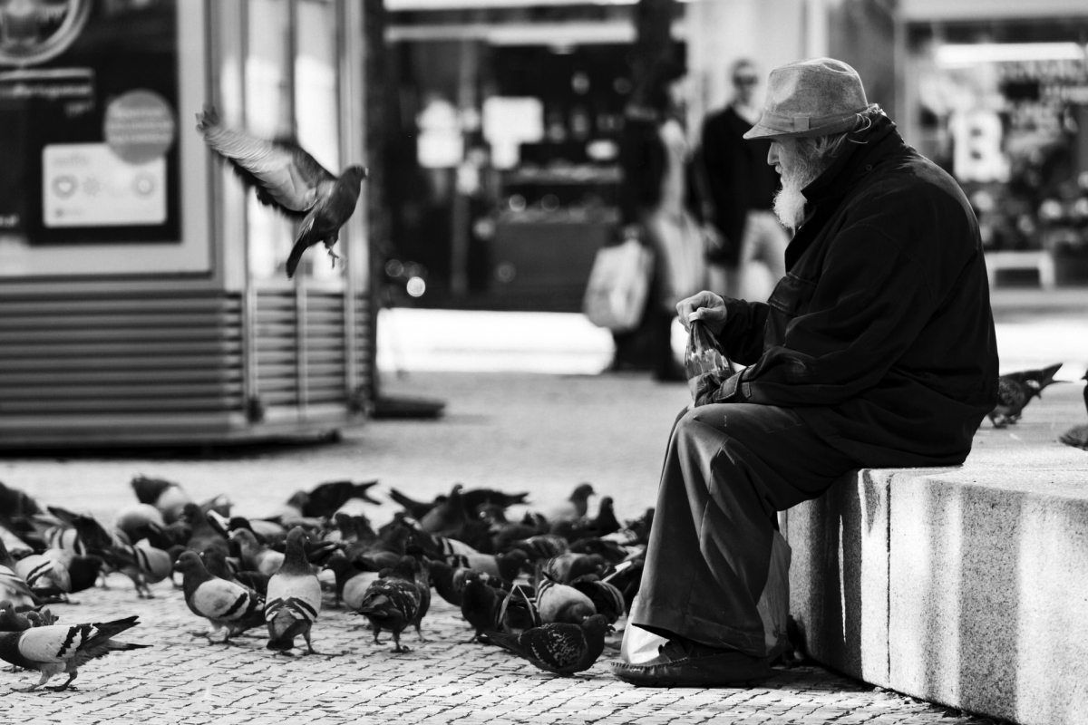
Composition in Photography
Street photography involves anticipation, since the photographer doesn’t usually have the choice of moving his subjects himself, but has to wait for them to take the most suitable position within the frame..

Slide 8
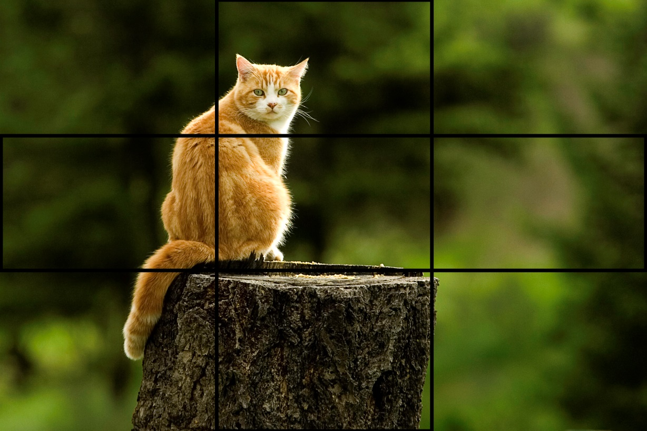
Types of composition
Rule of third
The rule of thirds is a very simple and effective way to frame your composition, and today most digital cameras include compositional grids divided into thirds for composing images

Slide 9
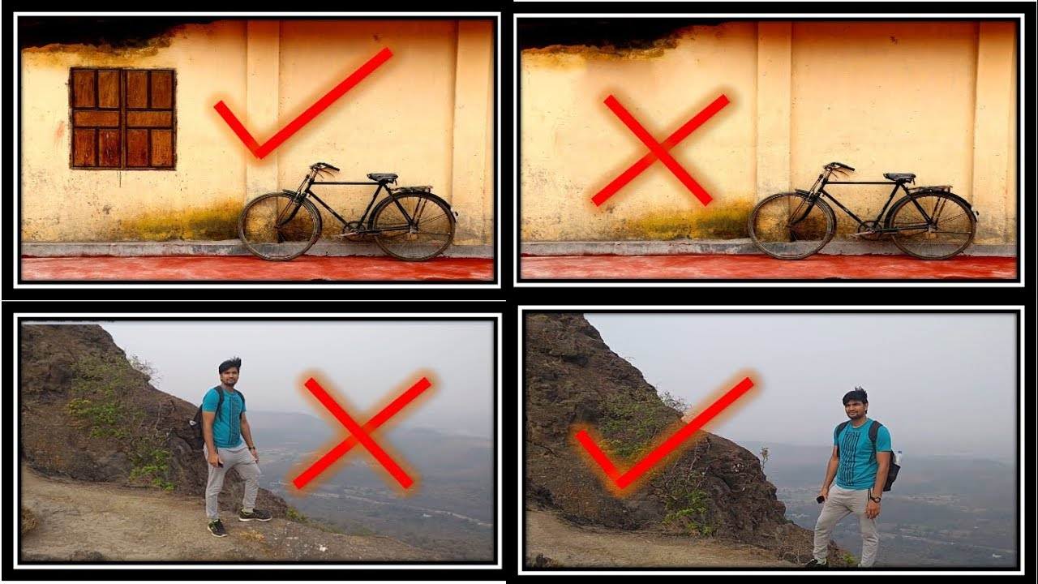
Types of composition
balance
your composition looks better if you place something smaller or less significant in the other third of your image, bringing an overall sense of balance to your photo.

Slide 10
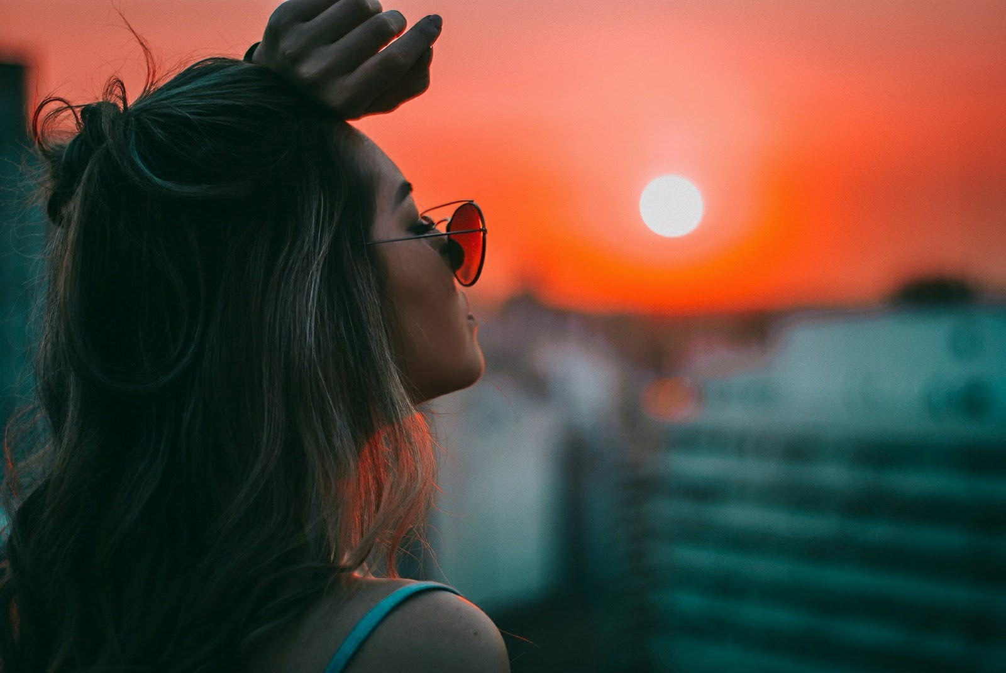
Types of composition
balance
your composition looks better if you place something smaller or less significant in the other third of your image, bringing an overall sense of balance to your photo.

Slide 11
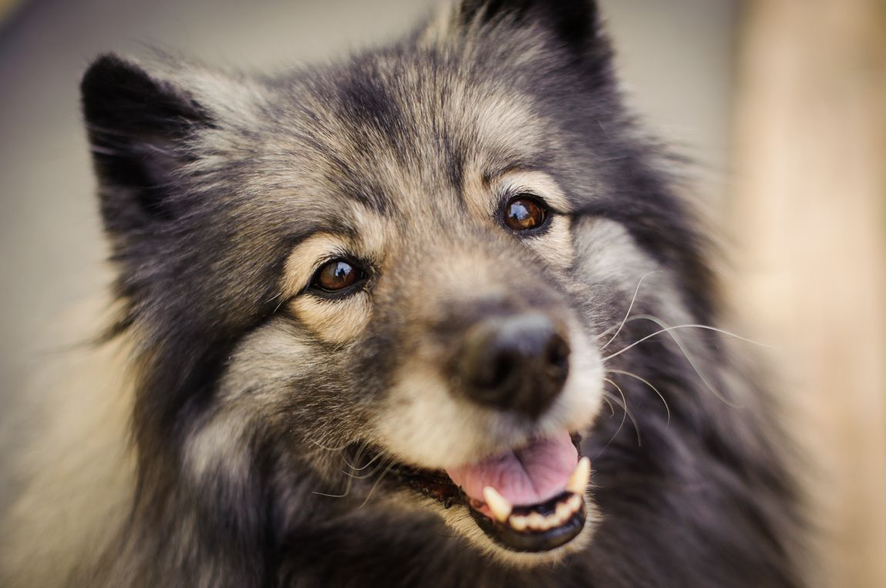
Types of composition
Fill the frame
This might seem like it’s breaking the rule of thirds, but it’s really just a different approach that will give you a different effect. Imagine shooting a full-body portrait of your dog or flower .

Slide 12
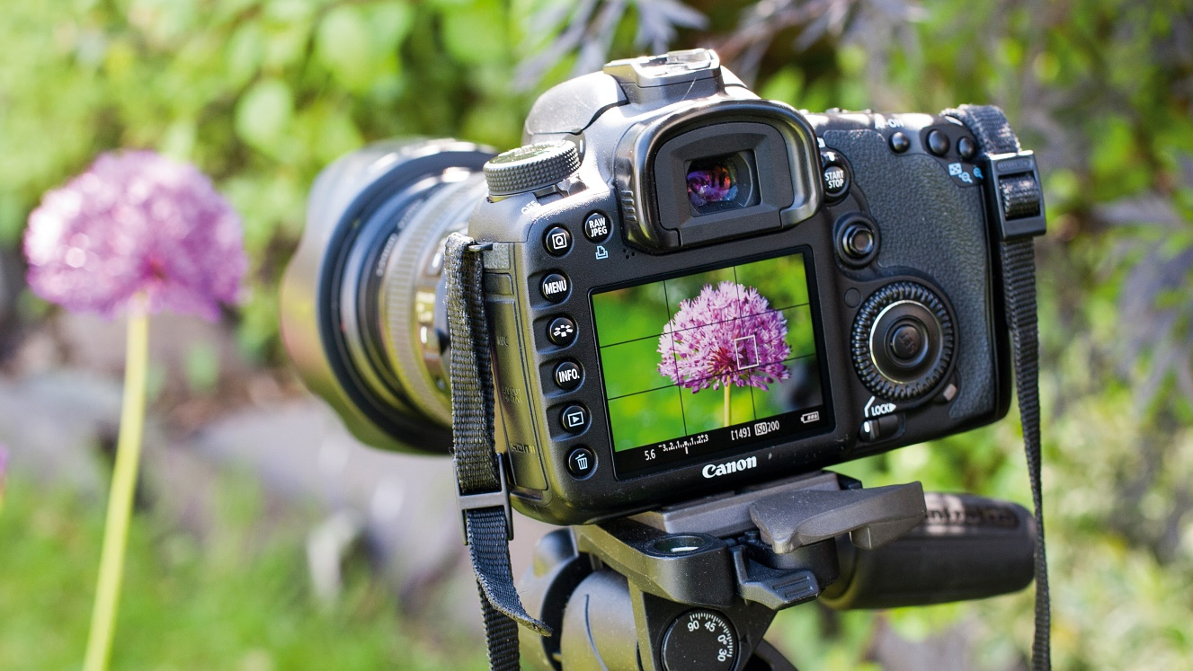
Types of composition
Fill the frame
You might place the flower in the frame according to the rule of thirds. But if you want to focus on its adorable features, filling the frame with the whole flower is an awesome way to do that. This also works wonders on your self-portraits.

Slide 13
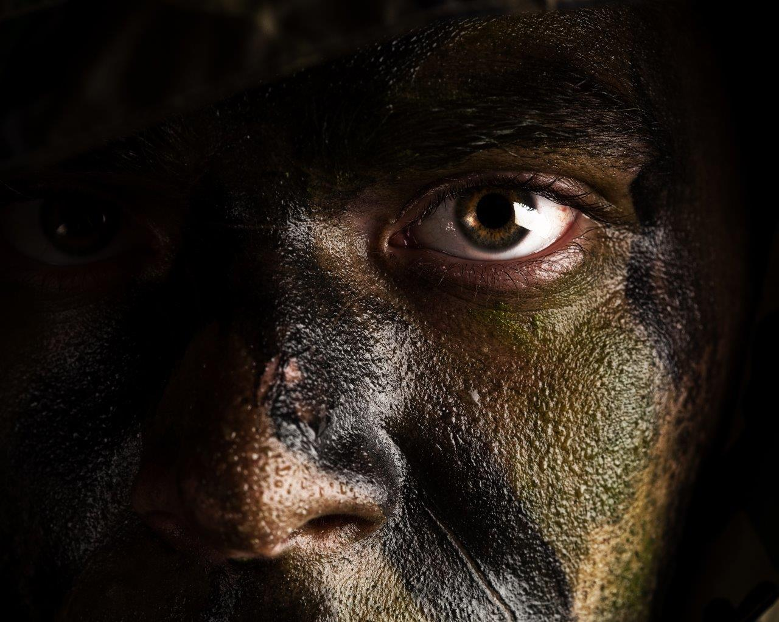
Types of composition
Fill the frame

Slide 14
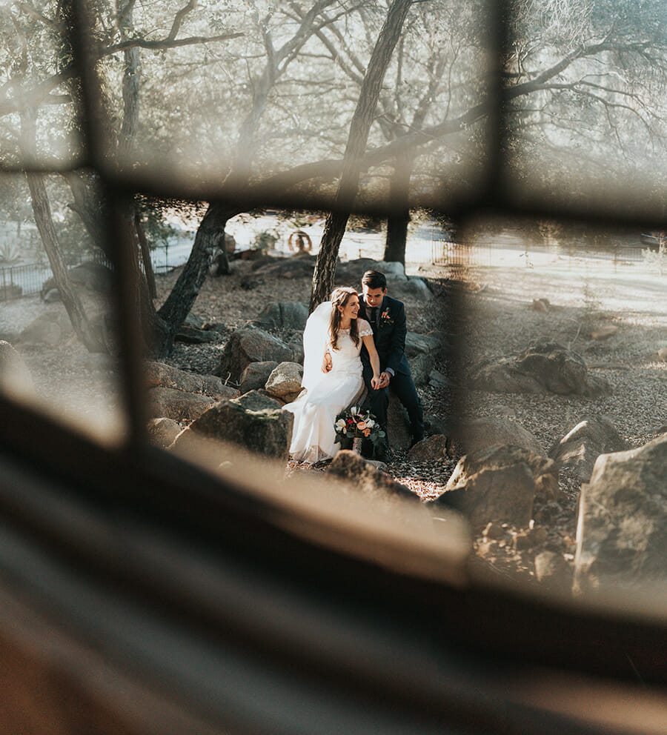
Types of composition
Use Frames
Almost anything can be a frame in your image composition. For urban photographers, a bridge is a perfect example of a framing element you can use. If you’re shooting out in nature, trees are usually used as natural frames for your main subject.
If there’s nothing in an image composition to guide the eye, the photo can seem boring or incomplete

Slide 15
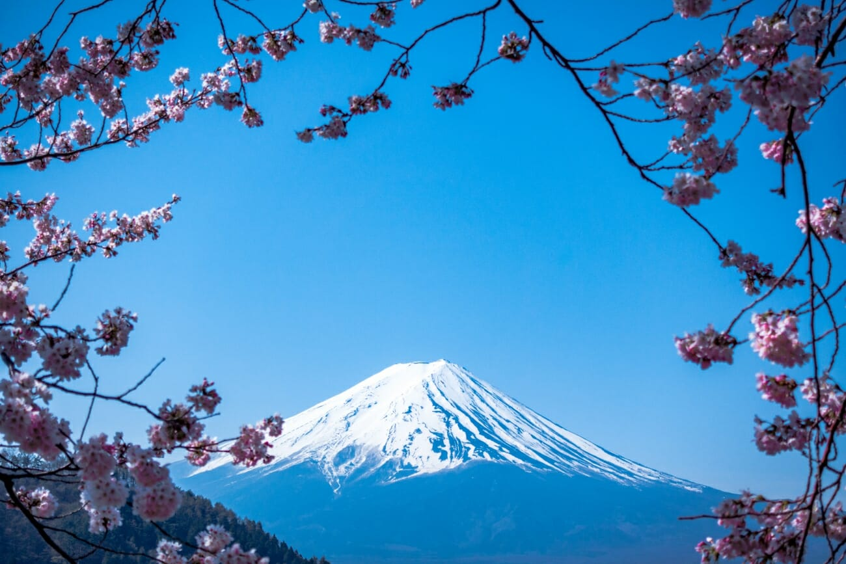
Types of composition
Use Frames
By using a frame in your photo composition, you’re creating an element that emphasizes the importance of your main subject in a way that is visually appealing, without being distracting or taking away focus.

Slide 16
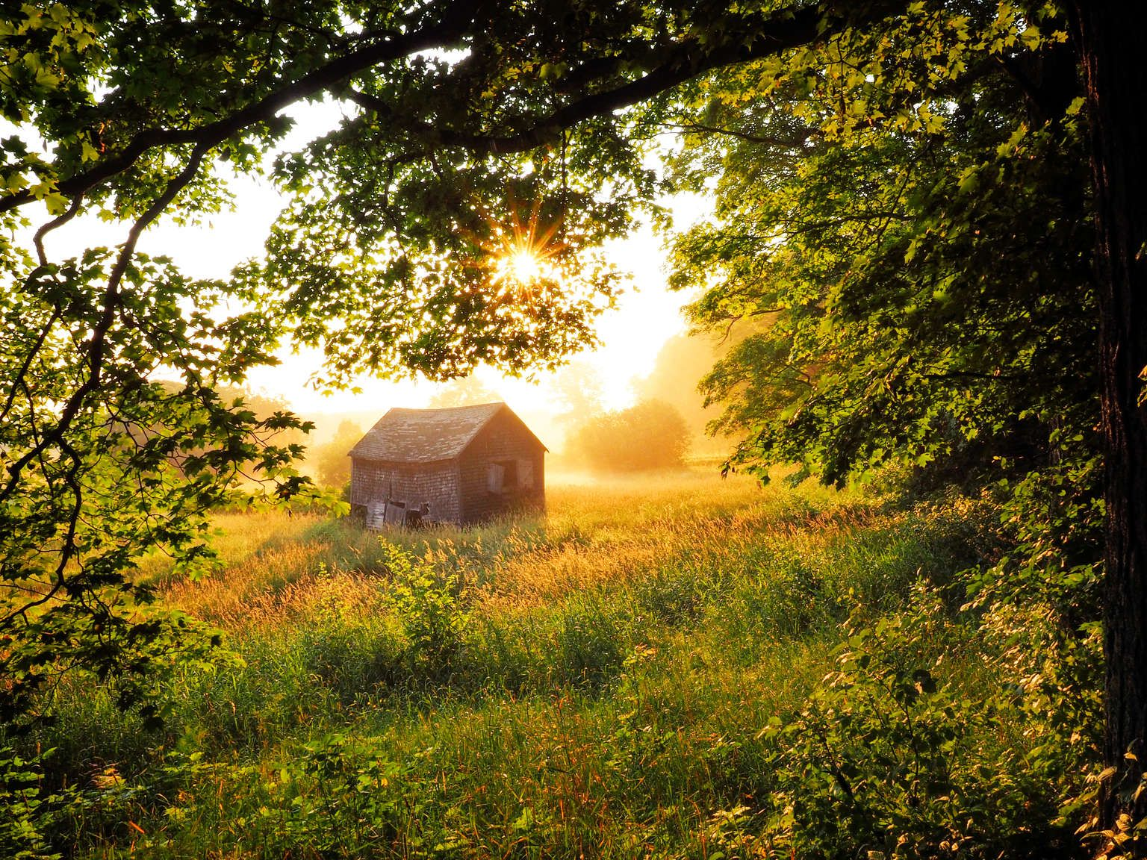
Types of composition
Use Frames

Slide 17
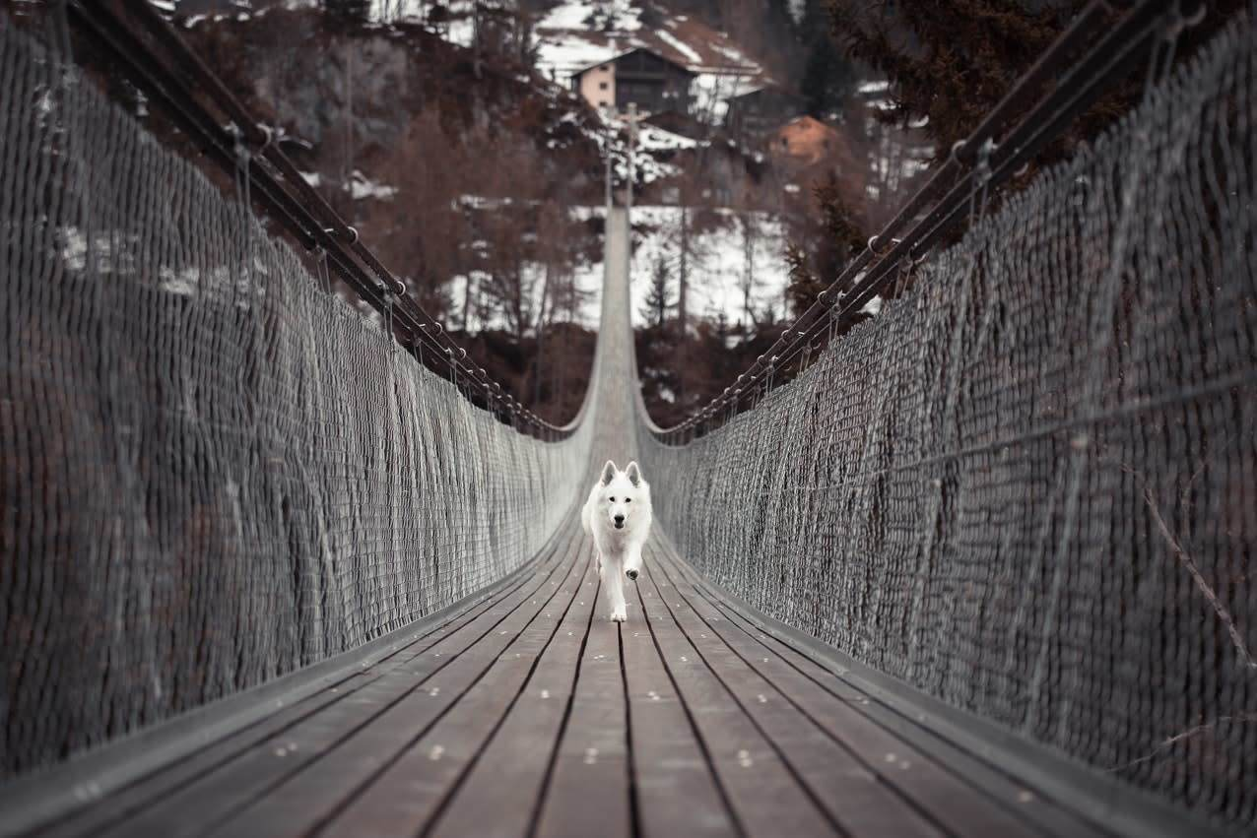
Types of composition
Leading Lines
This photo composition rule can pair really well with the last rule about framing! What’s a leading line ? Basically, it refers to using natural lines or shapes to guide the eye towards your main subject.

Slide 18
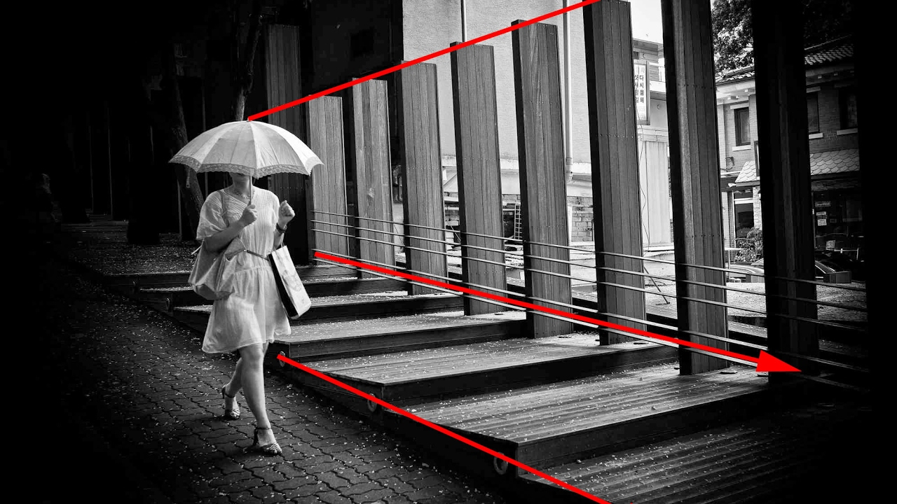
Types of composition
Leading Lines
The key to this photo composition tip is to take a big-picture view of the scene you are shooting, and to spot the elements that you can use as leading lines. Look for things like rivers, train tracks, doorways or shadows, and get creative!

Slide 19
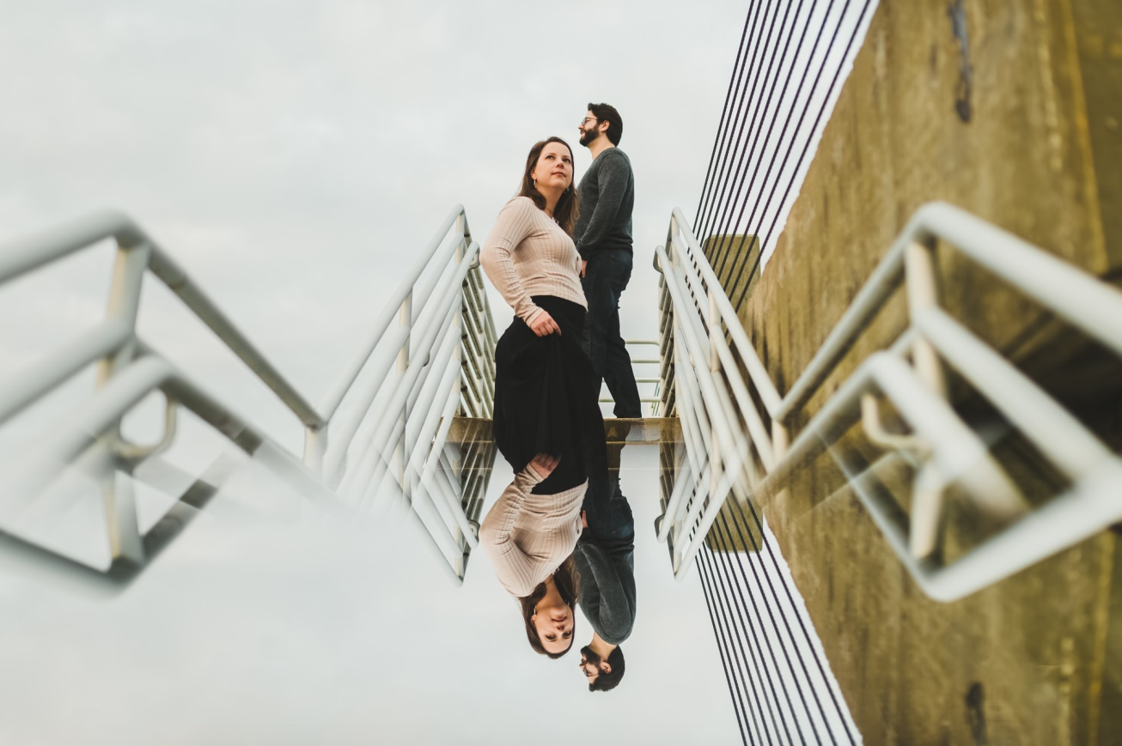
Types of composition
Leading Lines
This principle of composition isn’t just about using straight lines—you should scope your scene for diagonal, curvy, zigzag, and radial leading lines, too.

Slide 20
Conclusion
Well that is a little bit of composition we have discussed today in photography, we also do apply these in photojournalism as they play big part in helping the image to tell the story

Slide 21
The end
Thank you

